Slide 1
Model Calibration
CE EN 547 – BRIGHAM YOUNG UNIVERSITY

Slide 2
Lecture Objectives
Understand the role that calibration plays in the modeling process
Be familiar with both manual and automated approaches to model calibration
Understand the various error norms used to to quantify calibration
Understand the concept of model uniqueness

Slide 3
Calibration
Solution is computed by model
Simulated heads and flows are compared to field observed values
Input parameters (K, recharge, etc.) Are adjusted until model outputs match field observations

Slide 4
Types of Calibration
Trial and error
  Manually tweak inputs and re-run model
Automated parameter estimation
  Optimization utility is used to adjust input parameters in a systematic fashion
  PEST, UCODE

Slide 5
When is a model “calibrated”?
We should not expect a perfect fit between simulated and observed values due to:
  Measurement error
  Simplifying assumptions
  Uncertainty in inputs (river stages, estimated pumping rates, etc.
We generally try to get the simulated values within a certain “window” of the field observations:

Slide 6
Calibration Error Norms
Mean Error
Mean Absolute Error
Root Mean Squared Error
Each error norm provides a numerical measure of how well the model is calibrated

Slide 7
Error Norms, cont.
Weighted errors:
where:
Standard deviation can be derived from interval and confidence

Slide 8
Error Norms, cont.
Sum of Squared Weighted Residuals:
where:

Slide 9
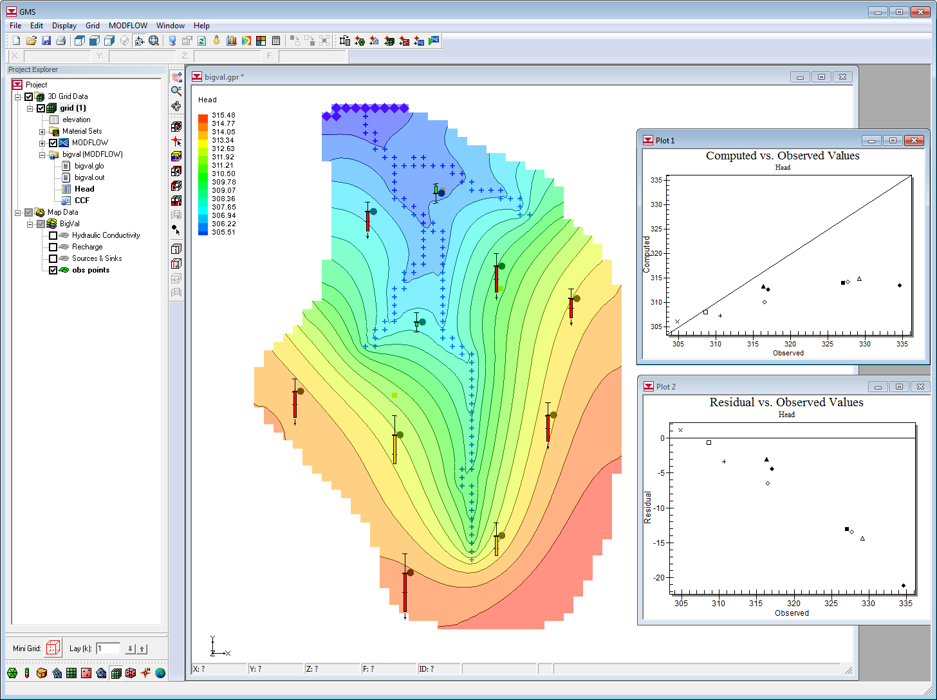
Calibration in GMS
Observation points
Flow observations
Calibration statistics
Automated parameter estimation with PEST

Slide 10
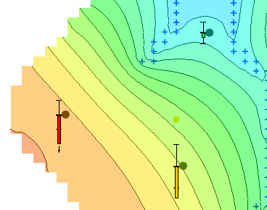
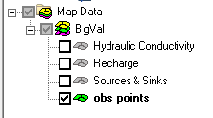
Observation Points
Primarily used for head values observed in monitoring wells
Points are contained in an “Observation Coverage” in the Map module

Slide 11
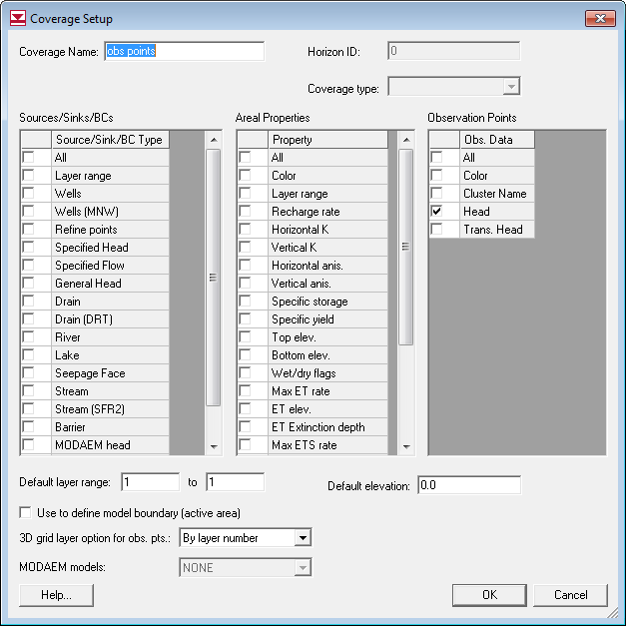
Observation Coverage Setup

Slide 12
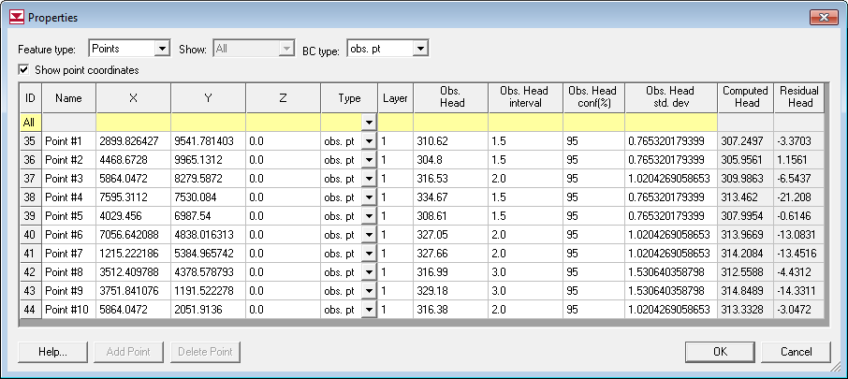
Observation Point Properties

Slide 13
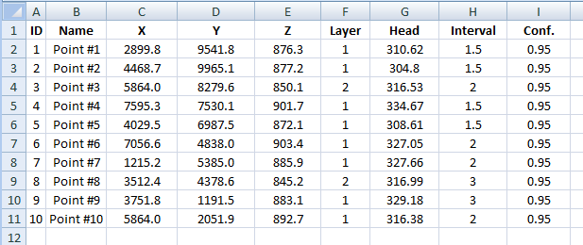
Importing Calibration Points
Can be entered/organized in spreadsheet
Import options
  Save to *.txt file and open using Text Import Wizard
  Cut and paste directly to Properties dialog
Required. All other columns are optional.

Slide 14
Calibration Targets

Slide 15
Magnitude of Error

Slide 16
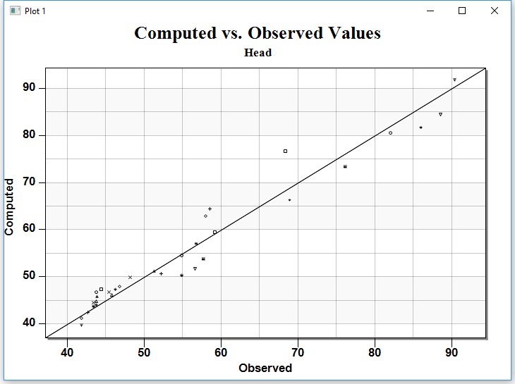
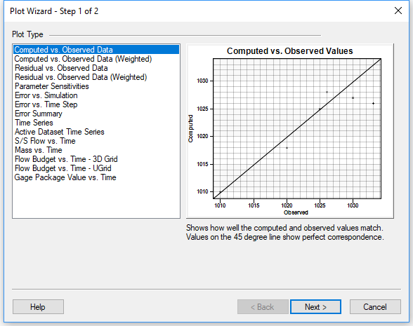
Calibration Statistics Plots
Click on Create Plot macro
Select plot type

Slide 17
Flow Observations
Represents
  Gain/loss in streams
  Gain/loss in reservoirs and lakes
If flow observations are not included, the solution may be non-unique
+Q
-Q

Slide 18
Model Uniqueness
Consider a model of a basin where the only input is recharge. Water leaves system through stream and spec. head boundary. Main parameters are recharge and K.
Let’s look at cross section through main axis of site (next slide)

Slide 19
Model Uniqueness
Calibration is achieved by adjusting parameters so that the water table raises or lowers until it fits the head observations
In order to lower water table:
  Increase K (water leaves system more rapidly)
  Reduce Recharge (less water entering system)
In order to raise water table:
  Decrease K (causes water to mound)
  Increase Recharge (causes water to mound)

Slide 20
Model Uniqueness
Looking at head observations only, calibration can be achieved via:
  Low K, low recharge
  High K, high recharge
Theoretically, there are an infinite number of combinations of recharge/K that will “calibrate” the model

Slide 21
Model Uniqueness
If we include a flow observation for the stream, we eliminate one unknown/degree of freedom from the system since the recharge then becomes fixed.
The only remaining unknown is then the hydraulic conductivity (K) and the number of combinations of parameters resulting in “calibration” is drastically reduced

Slide 22
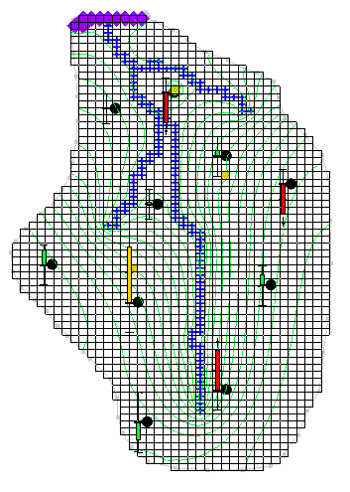
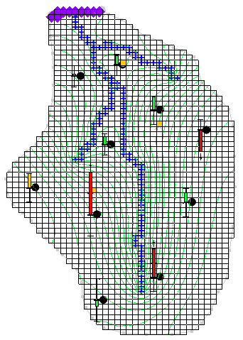
Example
In both cases, R is fixed and K is allowed to vary.
K=0.8
R=0.0012
Error (SSWR) = 142
K=0.2
R=0.0003
Error (SSWR) = 157

Slide 23
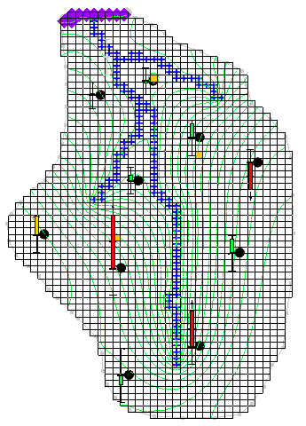
Example, cont.
In this case, we add a flow observation to the river network and solve again for K and R
K=0.42
R=0.00067
Error (SSWR) = 125 (including flow error)

Slide 24
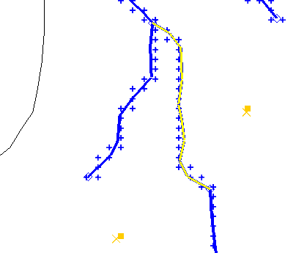
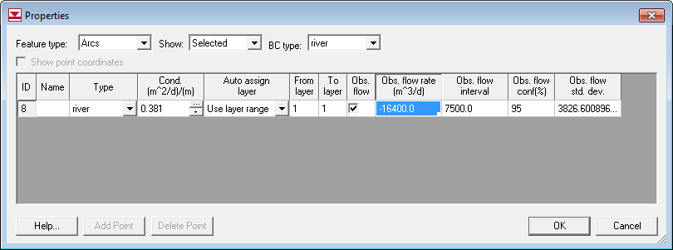
Observed Flows
Assigned to arcs and polygons in source/sink coverage

Slide 25
Arc Groups
Observed flows may span multiple arcs
Arc group must be defined so that computed flow is summed correctly
Create Group
  Select arcs
  Select Create Arc Group
Assign Flow
  Select with Select Arc Group tool

Slide 26
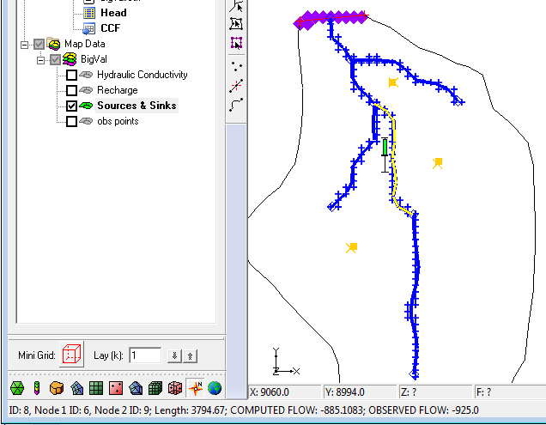
Displaying Computed Flows
Selecting object displays flow
Multi-select for total flow

Slide 27
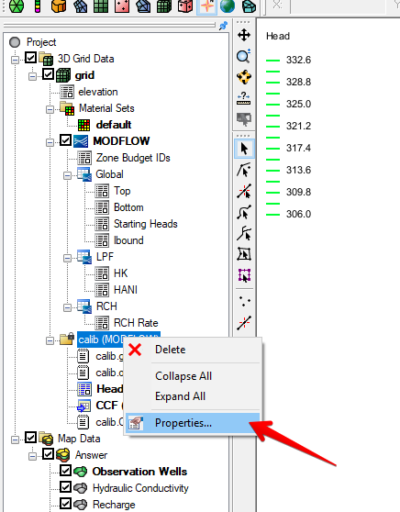
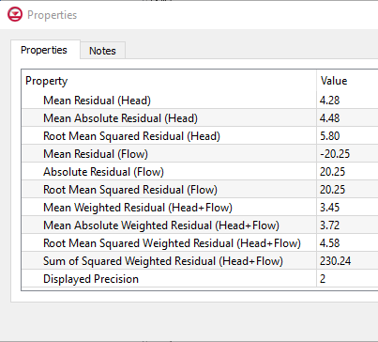
Comprehensive Error Summary
Right-click on solution folder in Project Explorer window
Select Properties

