Slide 1
MODFLOW – Introduction Organization & Main Packages
CE EN 547 – BRIGHAM YOUNG UNIVERSITY

Slide 2
Code Selection – Model Design
We are now at this spot in the model development process
MODFLOW is generally a safe and dependable choice for a model code
Model design = construction of numerical grid and model inputs

Slide 3
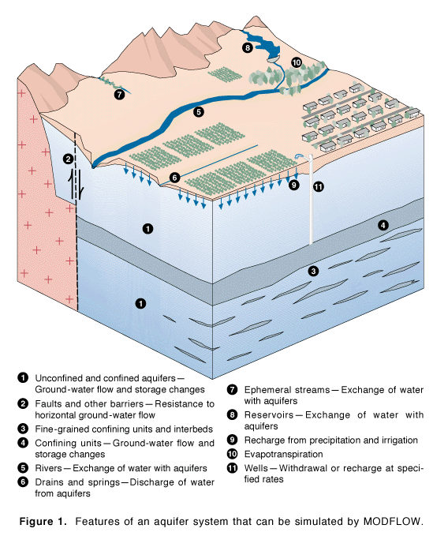
Developed by McDonald & Harbaugh of the USGS, 1983
Public Domain
Most widely used groundwater model
Steady-state or transient saturated flow
Versions:
MODFLOW 88
MODFLOW 96
MODFLOW 2000
MODFLOW 2005
MODFLOW-NWT
MODFLOW-USG

Slide 4
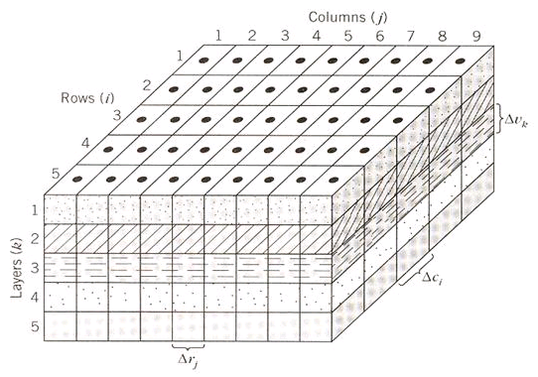
Finite Difference Model
3D Cartesian Grid
Cell-Centered

Slide 5
Grid Geometry
Orthogonal in xy
Thickness varies in z

Slide 6
Governing Equation
where:
K_{xx}, K_{yy}, K_{zz} = values of hyd. cond. along xyz axes
h = total head
W = Sources and sinks
S_{s} = Specific storage
t = time

Slide 7
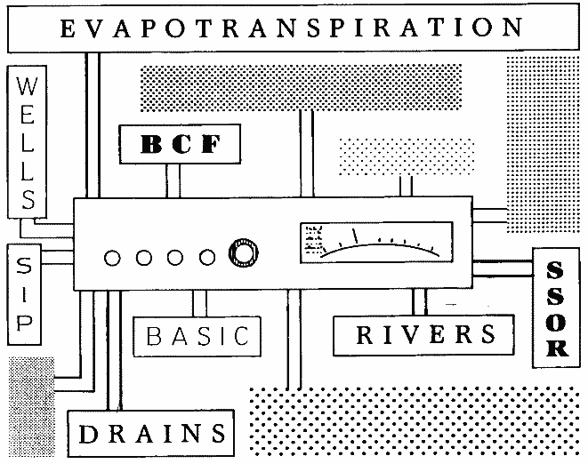
Processes & Packages
MODFLOW is divided into a series of processes & packages
Major tasks are organized as processes
More specific tasks are performed by packages
Each process may use one or more packages

Slide 8
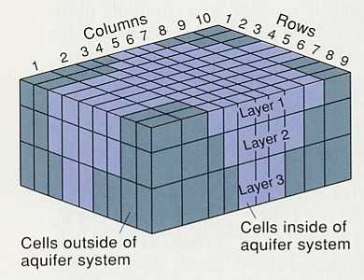
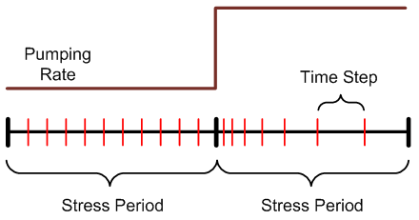
Global Process
Spatial discretization
# rows, cols, layers
Top/bottom elevations
Temporal discretization
Stress periods
Time steps
Units
Package Selection
Notes:
There is a layer discretization file and a global package file that are used by the Global Process.

Slide 9
Ground Water Flow Process
Formulation and solution of the ground water flow equation by the FD method
Main part of MODFLOW code
Includes
Flow package (BCF, LPF, or HUF)
Source/sink packages
Solvers

Slide 10
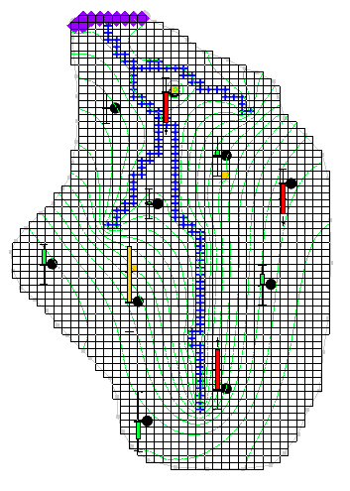
Observation Process
Used for model calibration
Calculates model-simulated heads and discharges to sources/sinks

Slide 11
Required Packages
Discretization
Basic
Output Control
Flow Package (BCF, LPF, HUF, UPW)
Solver (SIP, SSOR, PCG, GMG, etc.)

Slide 12
Optional Packages
CHB – Time Variant Specified Head
DRN – Drain
DRT – Drain Return Flow
ETS – Evapotranspiration Segments
EVT – Evapotranspiration
GAGE – Gage
GHB – General Head
HFB – Horizontal Flow Barrier
LAK – Lake
MNW – Multinode Well
MNW2 – Multinode Well 2
RCH – Recharge
RIV – River
SFR – Stream Flow Routing
STR – Stream-Aquifer Interaction
SUB – Subsidence
WEL – Well
UZF – Unsaturation Zone Flow

Slide 13
Active/Inactive Zones
Cells outside problem domain are marked as inactive
Controlled by IBOUND array
(1=active, 0=inactive, -1=specified head)

Slide 14
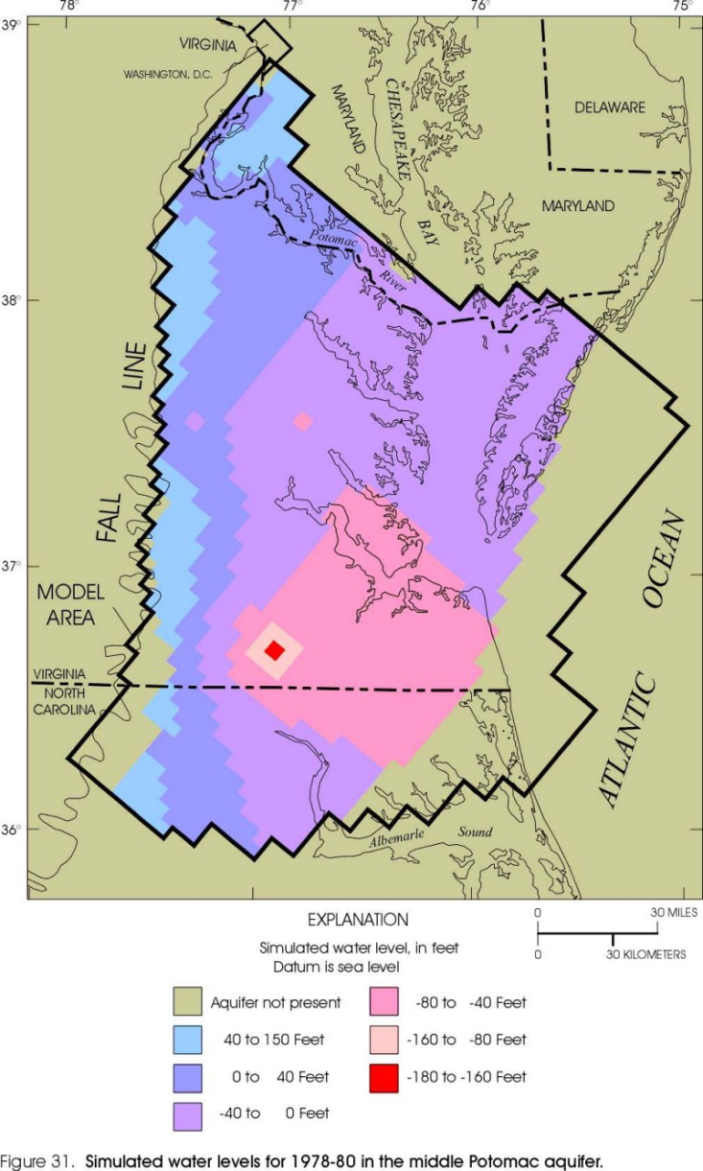
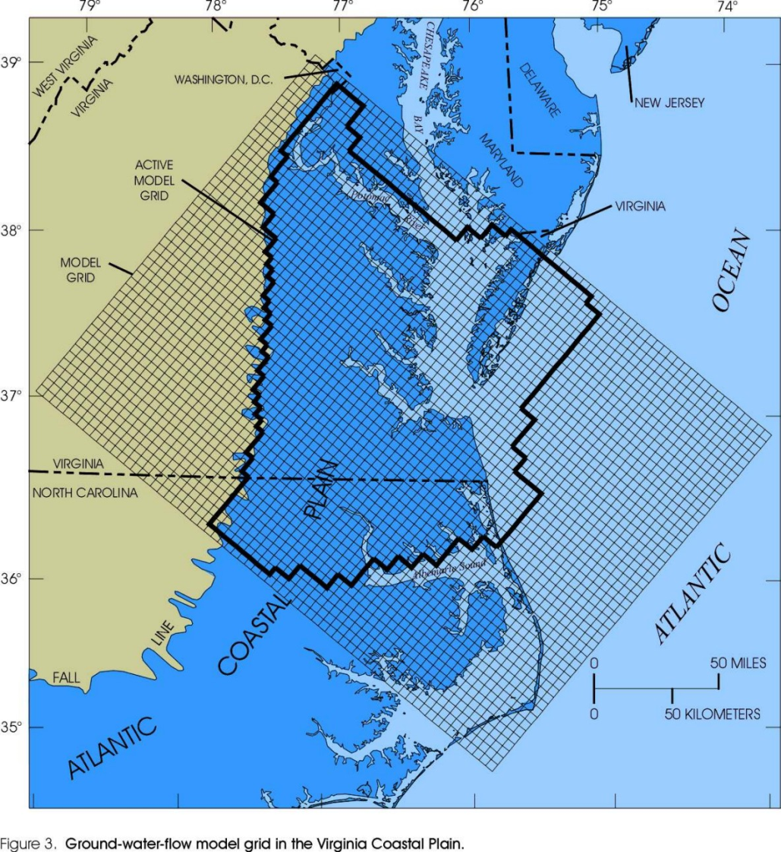
Virginia Coastal Plain Model
Notes:
http://va.water.usgs.gov/online_pubs/WRIR/98-4085/g-wfmcpasys_va.html

Slide 15
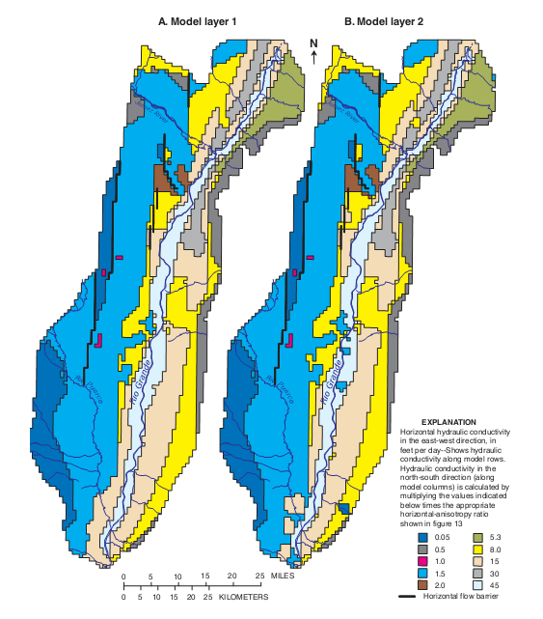
Flow Packages
Defines aquifer properties
Four options
Block-Centered Flow (BCF)
Layer Property Flow (LPF)*
Hydrogeologic Unit Flow (HUF)
Upstream Weighting (UPW), MODFLOW-NWT
*We will use the LPF package in this course

Slide 16
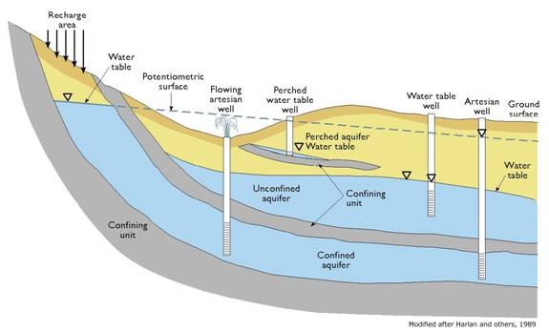
LPF - Layer Property Flow Package
User enters Kh, Kv and storage terms for all layers
Kv can be entered as directly or in terms of vertical anisotropy
Horizontal anisotropy entered on a cell-by-cell basis
Two layer types
Confined
Convertible

Slide 17
Well Package
Assigned to individual cells
Q can be steady state or transient
Extraction well (neg Q)
Injection well (pos Q)

Slide 18
DRN - Drain Package
Assigned to individual cells
Used to simulate
Agricultural drains
Springs
Creek beds
Required parameters
Elevation
Conductance

Slide 19
Drains
H_{ijk}
CD
Delev
When the head is above the drain elevation:
Q = CD (H_{ijk} - Delev) or
Q = CD (Delev - H_{ijk}) for proper sign on Q

Slide 20
Drains
CD
Delev
H_{ijk}
When the head is below the drain elevation:
Q = 0

Slide 21
Conductance
Darcy’s Law:
where
q = flow rate
k = hydraulic conductivity
Dh = head difference
L = flow length
A = gross cross-sectional area

Slide 22
Conductance, Cont.
Darcy’s law can be rewritten as:
where
The appropriate values for k, A, and L must be determined on a case-by-case basis

Slide 23
Sample Conductance Calculation
Length of overlap of river on cell

Slide 24
Recharge Package
One value assigned to each vertical column
Represents recharge due to precipitation
Can be steady state or transient
Infiltration rate must be assigned in correct units [L/T]

Slide 25
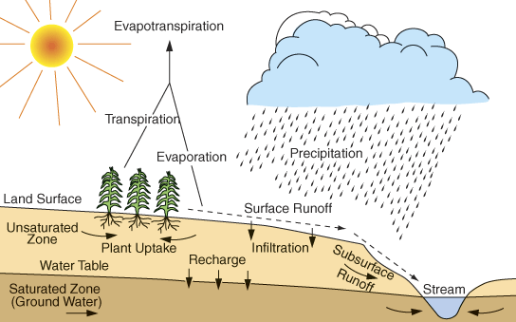
Factors Affecting Recharge Rate

Slide 26
Factors Affecting Recharge Rate
Rainfall
Runoff
Slope
Soil type
Land use
Evapotranspiration
Soil type
Vegetation

