Slide 1
MODFLOW – Part 2
Advanced Packages
CE EN 547 – BRIGHAM YOUNG UNIVERSITY

Slide 2
Additional Packages
RIV - River
STR - Stream-Aquifer Interaction
SFR - Stream Flow Routing
GHB - General Head
CHD - Changing Head Boundary
HFB - Horizontal Flow Barrier
EVT – Evapotranspiration
There are several additional packages that we will not cover. These are just some of the more commonly-used packages

Slide 3
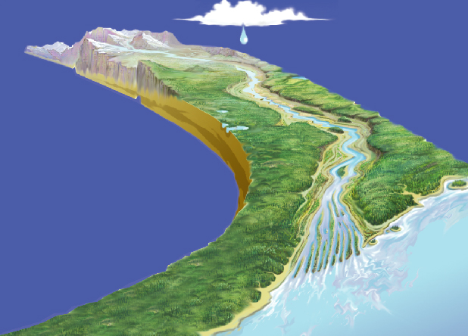
Stream-Aquifer Systems

Slide 4
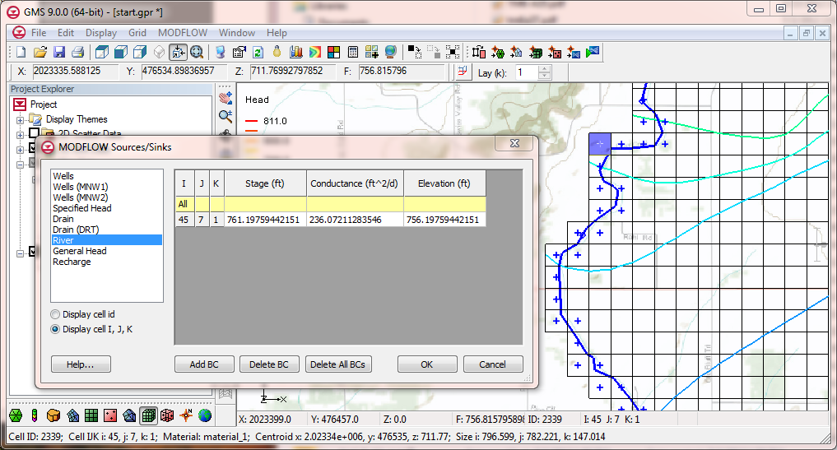
River Package
If head is above river stage, flow is from aquifer → river
If head is below river stage, flow is from river → aquifer

Slide 5
Idealized Representation
H_{ijk} = Head in cell
HRIV = Stage in river
CRIV = Conductance of river bottom sediments
RBOT = Elevation of bottom of sediments
QRIV = Flow between aquifer and river

Slide 6
Case #1 – Head Above River Stage
QRIV = CRIV * (HRIV - H_{ijk})
(-Q signifies flow out of cell)

Slide 7
Case #2 – Head Below River Stage But Above River Bottom
QRIV = CRIV * (HRIV - H_{ijk})

Slide 8
Case #3 – Head Below River Bottom
QRIV = CRIV * (HRIV - RBOT)

Slide 9
River Conductance
Length of reach in each river cell is computed

Slide 10
River Conductance Calculation
Length of overlap of river on cell

Slide 11
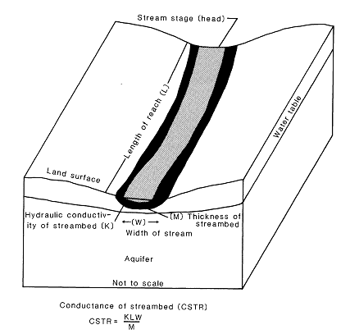
STR - Stream-Aquifer Interaction Package
Like the River Package, water can flow from aquifer to stream or vice versa.
Unlike the River Package, stage is not specified. Rather, flow is routed using simple channel hydraulics and a stage is computed using Manning’s equation.

Slide 12
STR Package - Segments and Reaches

Slide 13
STR Package - Required Attributes
Segments
  Incoming flow (for top segments and diversions)
  Width
  Slope
  Manning’s roughness coefficient
Reaches
  Conductance
  Elevation of the bottom of the streambed
  Elevation of the top of the streambed

Slide 14
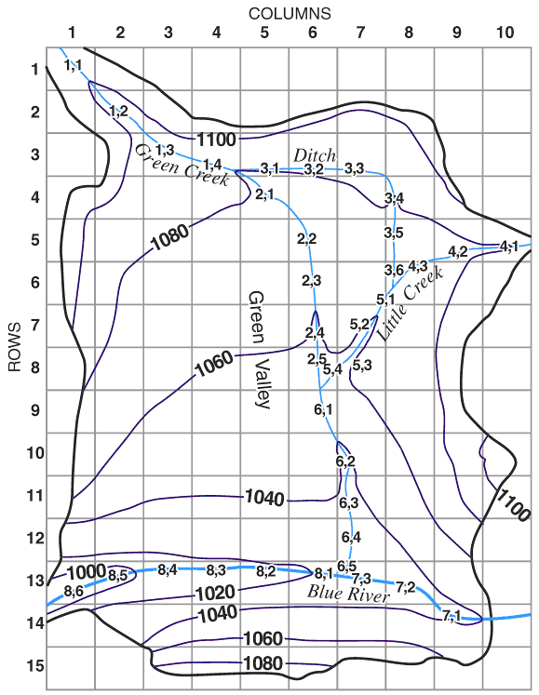
SFR - Stream Flow Routing Package
More advanced stream package
More options for inputs to streams
Interaction with the Unsaturated Zone Flow package

Slide 15
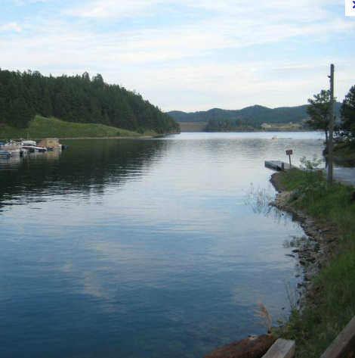
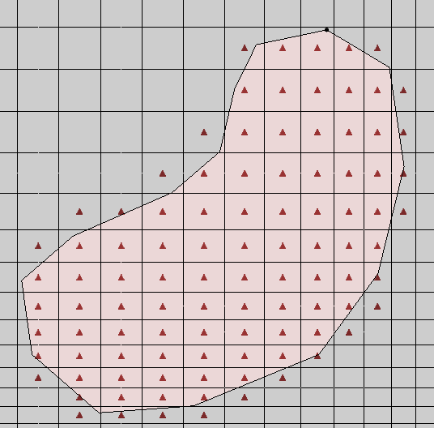
GHB - General Head Package
Often used to simulate lakes, reservoirs
Required parameters:
  Head
  Conductance

Slide 16
General Head
Q = Cgh * (H_{source} - H_{ijk})

Slide 17
General Head Boundary
Gaining Lake/Reservoir
Losing
Lake/Reservoir

Slide 18
Lakes and Reservoirs

Slide 19
CHD - Time Variant Specified Head Package
CHD = Changing Head
Original method for defining specified heads, works for static (steady-state) heads only
  IBOUND
  Starting Heads Array
CHD later added to allow for transient specified head boundary conditions
Can be used for steady-state case also

Slide 20
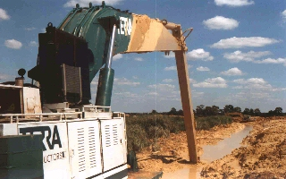
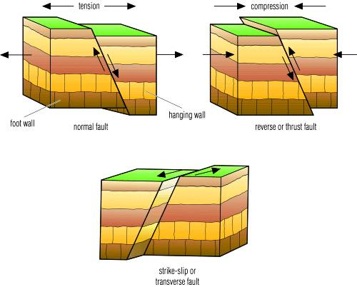
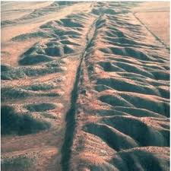
HFB – Horizontal Flow Barrier Package
Used to simulate low permeability barriers such as faults, sheet pile walls, and slurry trenches

Slide 21
HFB Cell Boundaries

Slide 22
HFB – Hydraulic Characteristic
Each instance is assigned a “hydraulic characteristic”

Slide 23

EVT – Evapotransporation Package
Simulates groundwater loss from evaporation and transpiration
User specifies:
  Maximum ET rate
  Surface elevation (usually ground surface)
  Extinction depth

Slide 24
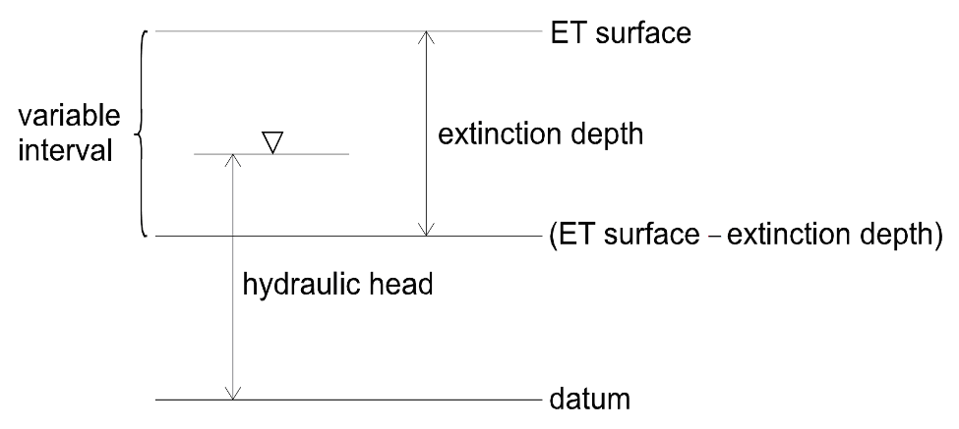
EVT – Evapotransporation Package
User specifies:
Maximum ET rate
Surface elevation (usually ground surface)
Extinction depth
ET rate = 0.0 when head below (ET surface – ext. depth)
ET rate = Max. ET rate when head above or equal to ET surface
ET rate varies when head between ET surface and ext. depth

Slide 25
MODFLOW-USG
New version of MODFLOW that allows for unstructured grids (no rows/columns/layers). Uses finite volume formulation.
Allows for more efficient grid refinement around features where rapid head change occurs.

