Slide 1
MODFLOW Solvers
CE EN 547 – BRIGHAM YOUNG UNIVERSITY

Slide 2
Lecture Objectives
Understand how an iterative solver works
Know the basic solver parameters and understand how they impact the solver
Understand how and why solvers don’t converge
Know how to troubleshoot solver convergence problems

Slide 3
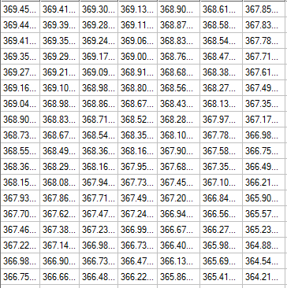
Iterative Solvers
Starting head values are iteratively “tweaked” until head differences satisfy governing equation
Each solver uses a different algorithm to modify heads
Sometimes we need to switch solvers or tweak solver parameters to get a model to converge

Slide 4
Solver Packages
Code | Name | Notes
SIP | Strongly Implicit Procedure | One of the original solvers. Simple but can have speed and stability issues.
SSOR | Slice-Successive Over-Relaxation | One of the original solvers. Can result in incorrect solutions. Not recommended.
PCG2 | Pre-Conditioned Conjugate Gradient | Good all-around solver. Default solver in GMS.
PCGN | PCG with Improved Non-Linear Control | Newer version of PCG2 package. More stable under some conditions.
NWT | Newton Solver | Used with MODFLOW-NWT. Best for wetting/drying problems.
GMG | Geometric Multi-Grid | Multi-grid solver requires more memory but results in faster solution. USGS version.
DE4 | Direct Solver | Direct matrix solution (non-iterative).
LMG/ SAMG | Algebraic Multi-Grid | Commercial multi-grid solvers. Outstanding performance but extra cost.

Slide 5
Basic Solver Options
Max number of iterations
Iteration stops at this point regardless of convergence
Convergence tolerance
Iteration stops if max head change is less than this amount
Acceleration parameter
Controls the amount of adjustment made to heads at each iteration
Options
=1.0 Default value. Head changes standard amount determined by solver
<1.0 Head change is reduced. Improves convergence but results in slower solution
>1.0 Converges faster but may be unstable

Slide 6
Solver Comparison
Using MODFLOW 2000
Run on Intel Core2 Quad CPU 2.4 GHz
Initial condition the same for all solvers
Starting heads = constant value OR
Starting heads = top of grid
HCLOSE = .001
RCLOSE = .001 (all solvers except SIP)

Slide 7
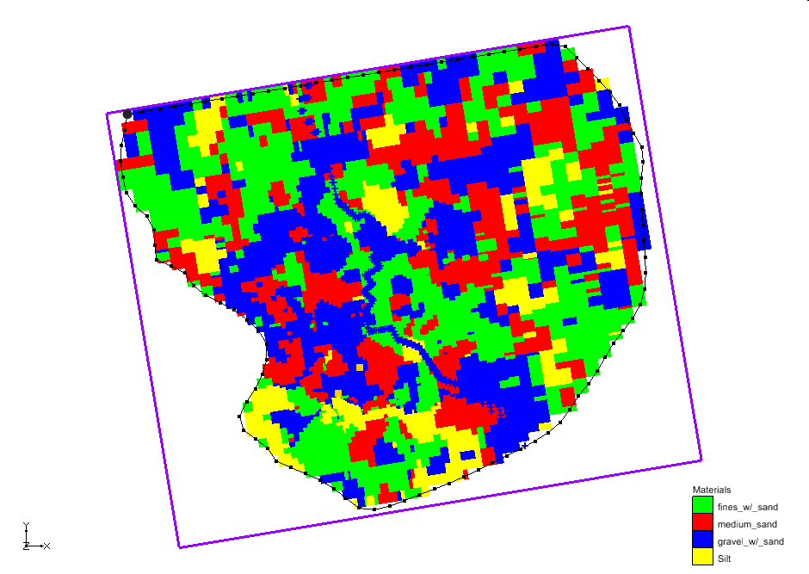
Solver Comparison Case #1
Woburn model
HUF package
8 layers
152,880 cells
SIP | PCG2 | SAMG | GMG
980 sec* | 64 sec | 39 sec | 87 sec
*had to reduce acc. param to 0.25 in order to converge

Slide 8
Solver Comparison Case #2
Head = 110 m
One layer model
Unconfined
96,000 cells
Injection Wells
SIP | PCG2 | SAMG | GMG
5 sec* | 6 sec | 2.5 sec | 6 sec
Extraction Wells
*had to reduce acc. param to 0.1 in order to converge, large flow budget error
Head = 90 m

Slide 9
Solver Comparison Case #3
Head = 110 m
Same as previous
Increased num cells to 216,000
Injection Wells
SIP | PCG2 | SAMG | GMG
16 sec* | 15 sec | 6 sec | 13 sec
Extraction Wells
*had to reduce acc. param to 0.05 in order to converge, large flow budget error
Head = 90 m

Slide 10
Solver Comparison Case #4
Head = 110 m
Same as previous
Changed to transient
4 stress periods, 10 time steps
Injection Wells
SIP | PCG2 | SAMG | GMG
50 sec* | 120 sec | 55 sec | 110 sec
Extraction Wells
*had to reduce acc. param to 0.05 in order to converge, large flow budget error
Head = 90 m

Slide 11
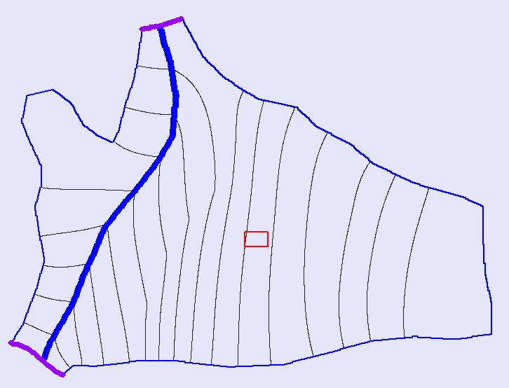
Solver Comparison Case #5
Two layer model
Unconfined
Steady state
600,000 cells
SIP | PCG2 | SAMG | GMG
587 sec* | 56 sec | 29 sec | 40 sec
*had to reduce acc. param to 0.05 in order to converge

Slide 12
Solver Comparison Summary
Num. Cells | # Layers | Trans. | SIP* | PCG2 | SAMG | GMG
152,880 | 8 | No | 980 | 64 | 39 | 87
96,000 | 1 | No | 5 | 6 | 2.5 | 6
216,000 | 1 | No | 16 | 15 | 6 | 13
216,000 | 1 | Yes | 50* | 120 | 55 | 110
600,000 | 2 | No | 587 | 56 | 29 | 40
*had to reduce acc. param in order to converge, some of the models had large flow budget error

Slide 13
Improper aquifer properties
Unbalanced flow budget
Improper initial conditions
Improper boundary conditions
Wetting and drying issues
Highly sensitive model
Etc.

Slide 14
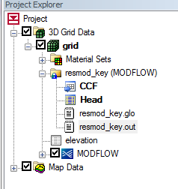
Troubleshooting Steps
Review command line output from MODFLOW (Run MODFLOW Window)
Run Model Checker
Look in MODFLOW output file (*.OUT)

Slide 15
Wetting and Drying
With most solvers, if head drops below bottom of cell, the cell becomes dry and is “turned off”
Can occur during any portion (iteration) of solution process, not just at end of time step
Causes
Head overshoot
Model parameters
Transient conditions

Slide 16
Head overshoot
Starting head
Solver guesses how much to adjust head downward
Cell goes “dry”, and is turned off during remainder of simulation
“Final” head
“Final” head
Bottom elevation
Bottom elevation
Computed head
Initial Condition
After One Iteration

Slide 17
Eliminating Head Overshoot
Starting head
Starting head is closer to final head
Iteration #1
Iteration #2
Starting head
Iteration #3
“Final” head
“Final” head
Bottom elevation
Bottom elevation
Reduce Acceleration Parameter
Improve Starting Head Estimates

Slide 18
Model Parameters
In many cases, cells are going dry due to:
Recharge too low
K too high
Etc.
Solution
Adjust parameters to better calibrate model

Slide 19
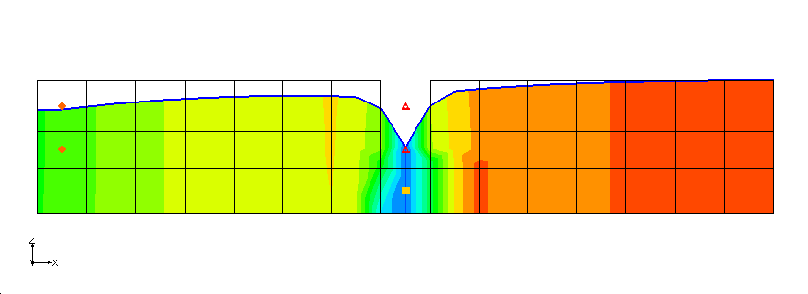
Transient Water Table
Transient conditions will cause heads to fluctuate and cells to go dry
Particularly an issue for multi-layer models

Slide 20
Rewetting Option
Option available in all flow packages (BCF, LPF, HUF)
Off by default
Rewetting increases solution time
May case solution to be less stable

Slide 21
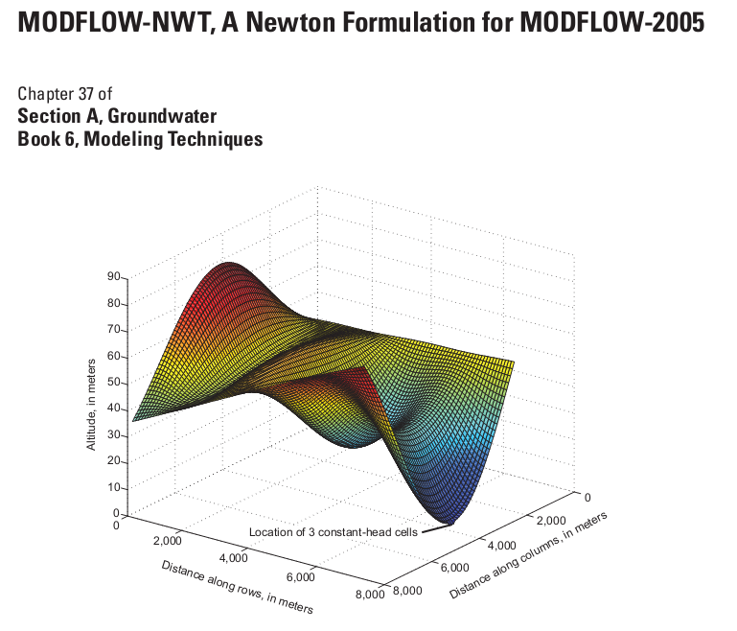
MODFLOW-NWT
New version of MODFLOW released in 2011
Designed to solve nonlinear problems due to unconfined conditions or nonlinear boundary conditions
Best solution for wetting and drying

